Slide 1
Term Project - Phase II
Presentation
ECE 445 (ML for ENGG):
Akshitha Ajayan Eric Jiang Safa Shaikh

Slide 2
Datasets
Forecasting Temperature in Szeged (2006-2016)
Least Squares Regression
Ridge Regression
Regression Tree
Fruits 360° (2017-2018)
Support Vector Machine Classifier
Logistic Regression Classifier
Classification Tree
Credit Card Fraud (September 2013)
K-Nearest Neighbor Classifier
Logistic Regression Classifier
Support Vector Machine Classifier

Slide 3
Original Dataset: Air Quality in Madrid (2018)
The csv file shows the air quality parameters (chemicals) measured at each of the stations in Madrid every 24 hours over the course of 4 months (January to April) in 2018
No one parameter for air quality (either have to estimate multiple parameters or choose a chemical as target and other chemicals as data)
Second option might not be appropriate for regression since the presence of other chemicals is not necessarily correlated to the presence of one chemical in the air

Slide 4
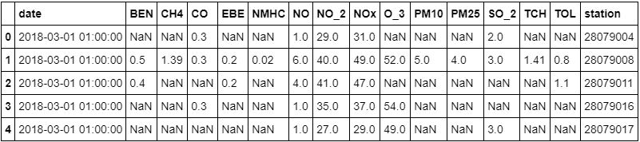
Air Quality in Madrid (2018) CSV
Many of the measurements are missing values (the only consistent measurements are for NO, NO2, & NOX), which greatly limits our data parameters

Slide 5
New Dataset: Weather in Szeged (2006-2016)
CSV file contains weather information on different dates in Szeged
Good for regression since we want to get a continuous value result (ie. the temperature based on parameters such as apparent temperature, humidity, wind speed, etc.) rather than identifying a label or a discrete value (like in classification) or creating groups of results (like in clustering)

Slide 6
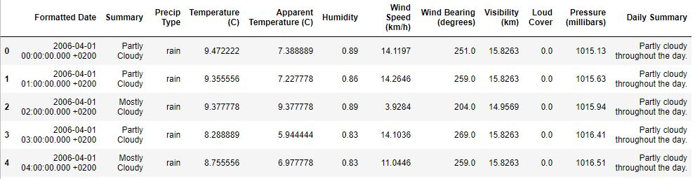
Weather in Szeged (2006-2016) CSV
Decided to use temperature (C) as our target column and used apparent temperature (C), humidity, wind speed (km/h), wind bearing (degrees), and visibility (km) columns as our data parameters

Slide 7
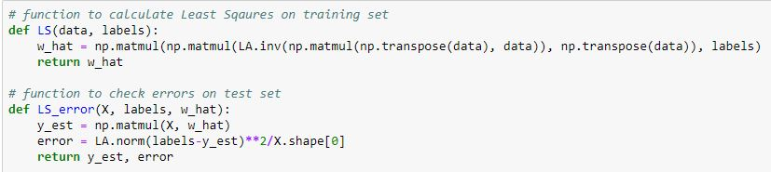
Least Squares
Regression aims to estimate the y=X*w function
LS estimates w using the following equation: (XX^{T})⁻¹X^{T}y
X is the training data appended with a column of ones, y is the target values for the training data
Run our test data using y=X*w_hat and check errors

Slide 8
K Fold CV
Cross validation to verify the results and that the data was not being overfit
Randomly split data in K fold (where K=5) and then used 4 folds for train and 1 fold for test
Repeated this over K times and averaged the predicted error

Slide 9
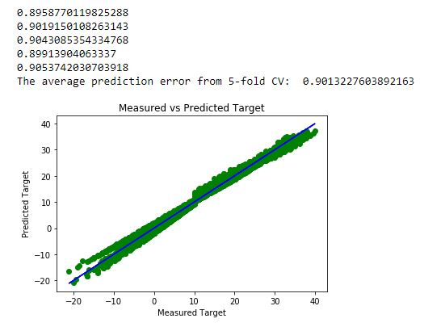
Least Squares Results

Slide 10
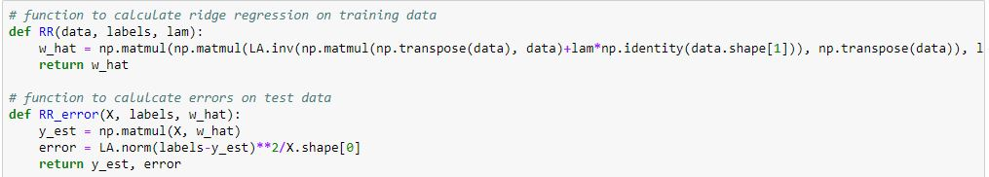
Ridge Regression
Regression aims to estimate the y=X*w function
RR estimates w using the following equation: (XX^{T}X+ƛI)⁻¹X^{T}y
X is the training data appended with a column of ones, y is the target values for the training data
Run our test data using y=X*w_hat and check errors
Again used K fold CV

Slide 11
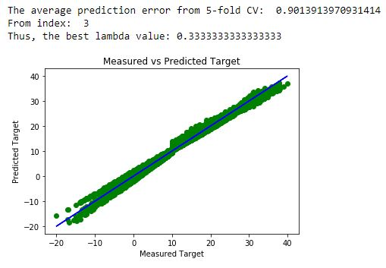
Ridge Regression Results

Slide 12
Regression Trees
Regression Trees take data in space R^M and partition the region in a greedy fashion. Binary splits are used to partition the region into R1 and R2 based on condition:
R1(j,s) = {x: xj<s}
R2(j,s) = {x: xj >= s}
We keep splitting until the number of samples in each region drop below a threshold
Then we take an average of the samples in the region and use that as an estimate for target values.

Slide 13
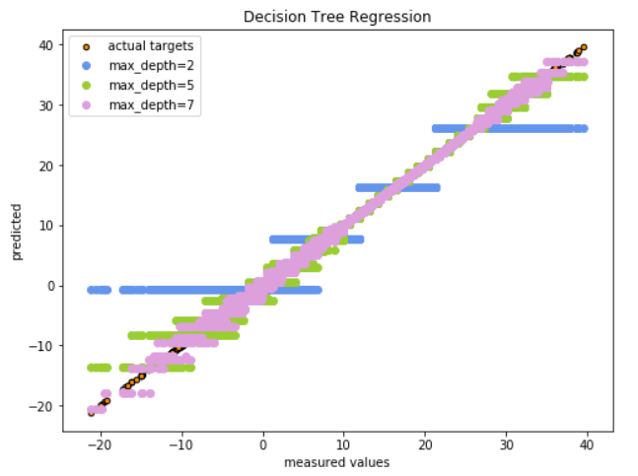
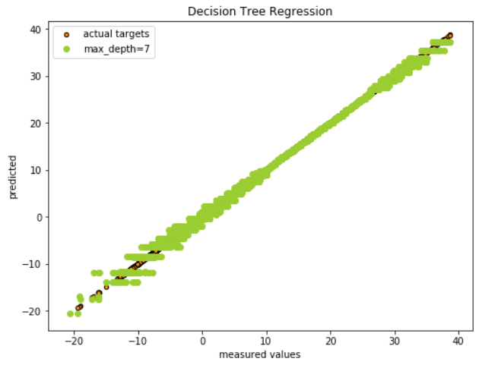
Results
On random split On validation data after k-fold CV (error= 0.16)

Slide 14
Conclusion
Least Squares and Ridge Regression had very similar errors
Regression trees had a much better result compared to LS and RR (~0.16 vs ~0.90)
K fold CV insured that we weren’t overfitting to our model

Slide 15
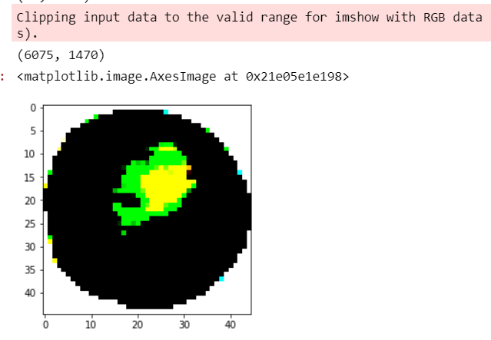
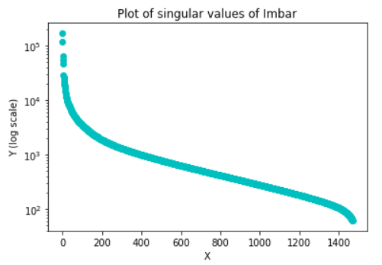
Fruits 360°
This dataset contains images of various fruits - we chose to develop a classifier to differentiate between bananas, limes, and pineapple.
Because the data was in image form, we had to flatten the RGB images and perform PCA.
We found that using the top 50 components would encompass 96.4% of the features.

Slide 16
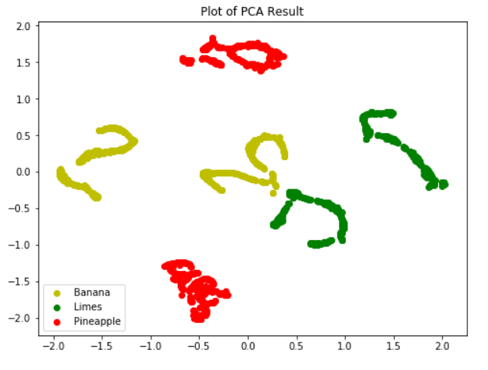
SVM on Fruits
SVM uses a hyperplane of form w^Tx +b to separate 2 classes.
This image tells us that SVM can perform well on the data because there is a way to clearly separate the 3 classes.
94% accuracy on training data
64% on validation - possible overfitting
K-fold cross validation was not done, so better results may be possible.

Slide 17
Classification Trees
Like regression trees, except we take the label of maximum probability in each region
Uses Gini Index to measure the variance of each class (Sklearn default metric)
Gini Index tells us how much error in the region for each class, using the variance for each class. Useful for multiclass error
Decide split with:
(j,s) = argmin [G_R1(j,s) + G_R2(j,s)]
Classification trees are non-linear classifiers, and they worked much better than SVM on our data
Achieved 100% accuracy

Slide 18
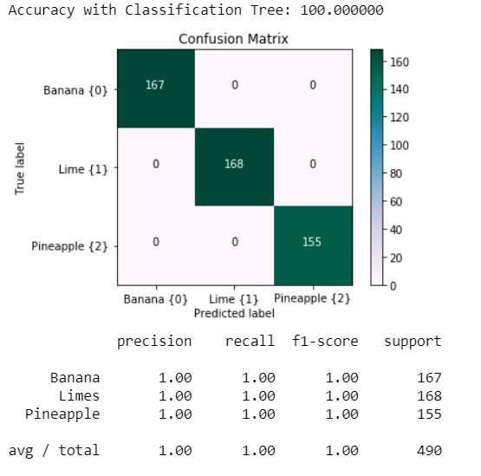
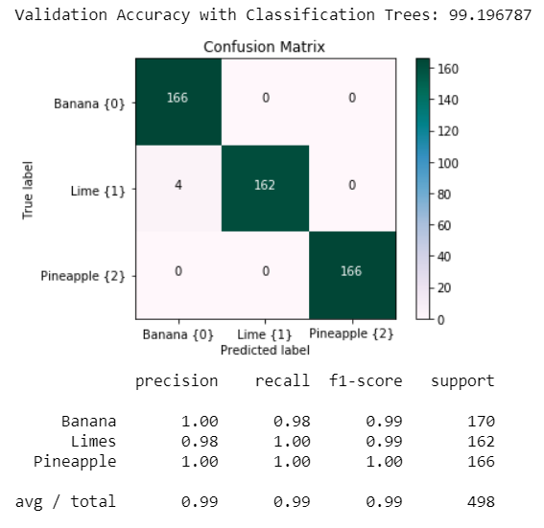
Results
After K-fold on Training: 100% accuracy On Validation Set: 99.2 % accuracy

Slide 19
Logistic Regression
Used skikit learn’s LogisticRegressionCV
Cs: default of 10, represents inverse of regularization strength which is used to determine if data is overfitting
Fit_intercept: default of True, including bias term in fitting
CV: used 5 for Stratified K Fold validation
Penalty: L2 (loss function)
Random State: 42 to randomize data
Logistic regression gives us the probability of the data being in that class
Tried both binary (one discussed in class) and multiclass
In multiclass, skikit learn uses one vs all approach (so loss isn’t a true multiclass loss, only an averaged loss of all other classes vs that one class)

Slide 20
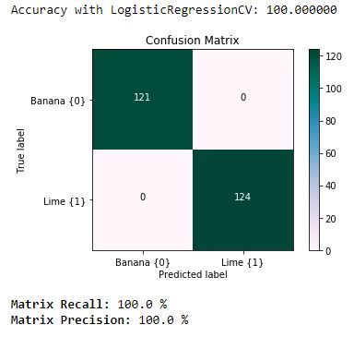
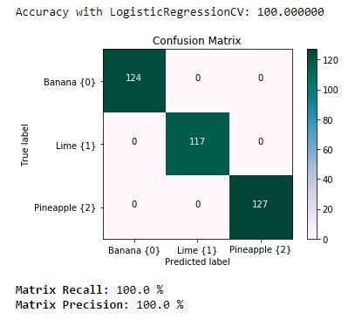
Logistic Regression Results

Slide 21
Conclusion
SVM performed with 94% on train/test and 64% on validation data
Classification Trees performed with 100% accuracy on test/train and 99.2% on validation data.
Logistic Regression performed with 100% accuracy
We can say that for classifying banana, limes, and pineapple, using Classification Trees or Logistic Regression would work best.

Slide 22
Credit Card Fraud
The dataset contains samples of European credit card transactions in two days of September 2013.
The objective using this dataset is to find optimal classifiers for detecting credit card fraud.
Due to confidentiality reasons, the the majority of the original features are unknown and instead have their PCA into 28 features V1 … V28
The only known given variables are:
Time - Time it takes to reach final transaction
Amount - Amount in the transaction sample
Class - Determines if fraud (1) or non-fraud (0)

Slide 23
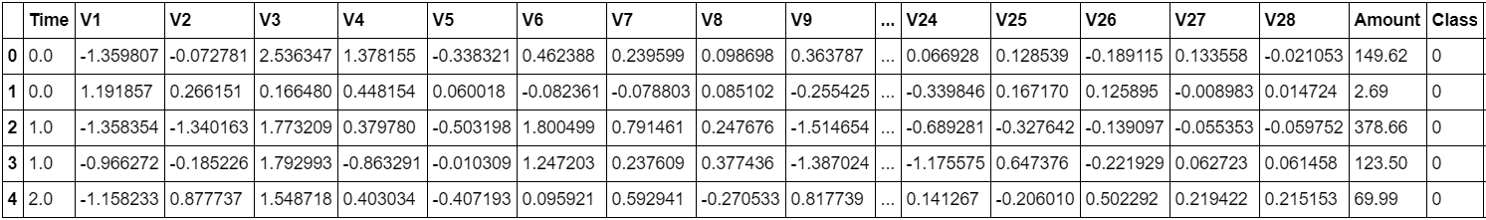
Credit Card CSV Header

Slide 24
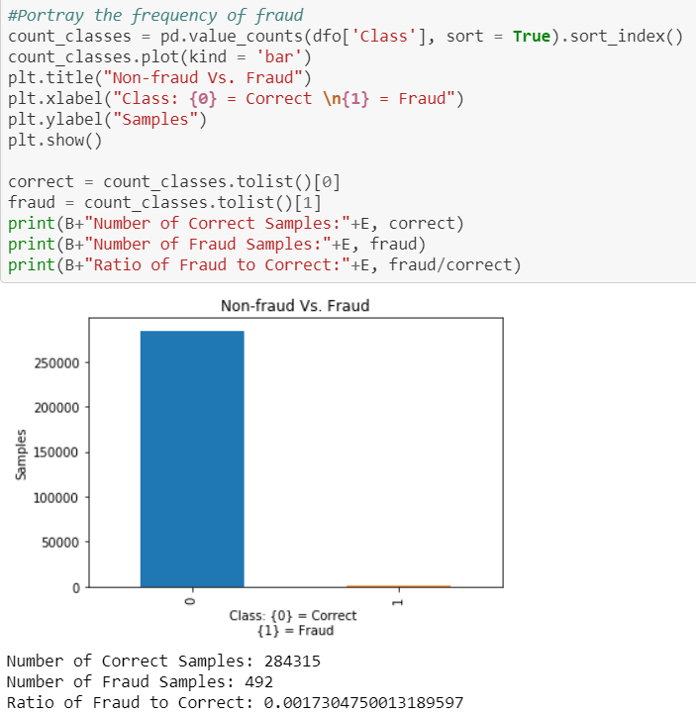
After loading the values, it is discovered that the majority of the 285,000 samples are non-fraud.
Only 492 samples were fraud, which is 0.17% of the entire dataset.
This means that the dataset is highly imbalanced.
To solve this, use a subset that contains 50% fraud, 50% non-fraud

Slide 25
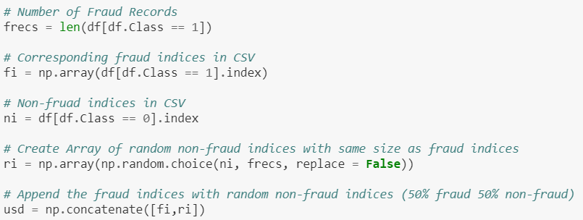
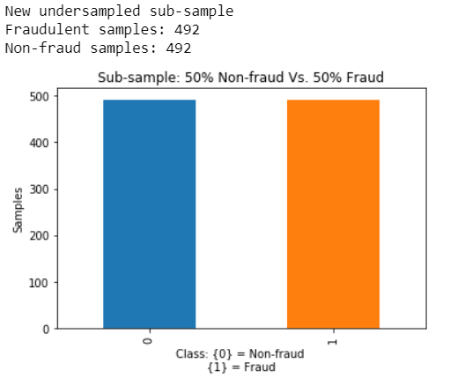
The data was scaled by centering/scaling with the mean and standard deviation.
Then 50% fraud was taken and random choice of 50% non-fraud was appended to form a subset of 492+492 samples.
Having a sub-sample would solve overfitting. With an imbalanced amount of samples as non-fraud, the classifiers will assume that almost all cases are frauds leading to poor accuracy.

Slide 26
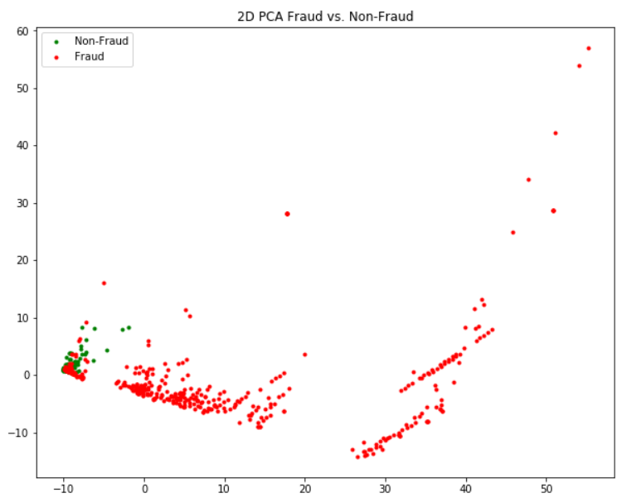
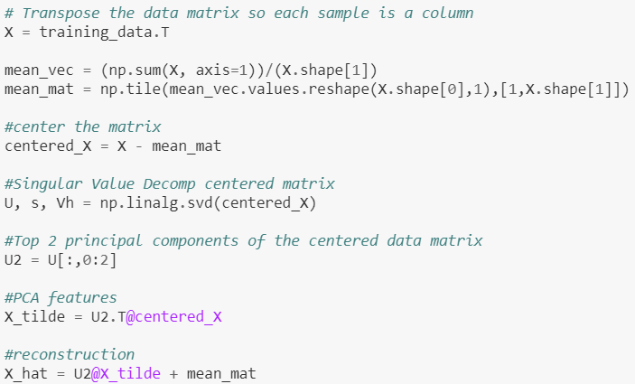
85% of the data was taken for training and 15% was taken for testing.
The data was then PCA’d into two dimensional features.
As shown, the majority of fraudulent red points can be separated from the non-fraud green points. However, looking at the left side, a lot of green and red are clumped together leading to possible errors.

Slide 27
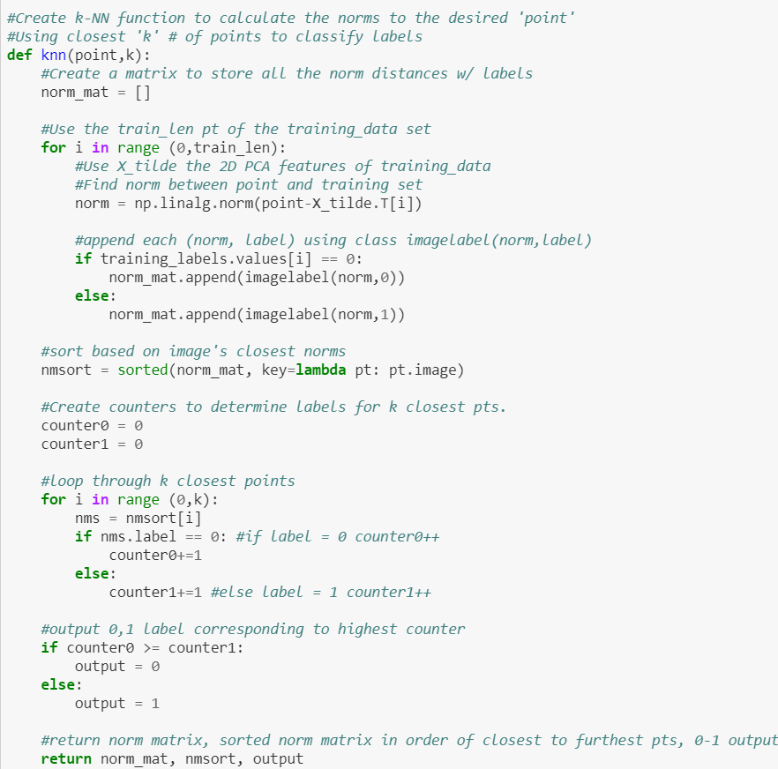
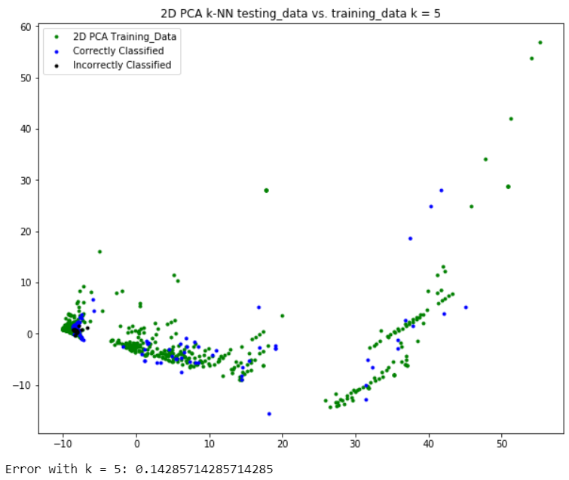
Using k-NN with k = 5, an error of 14% was found. This varied depending on the random subsets and test folds. But was generally around the 14% error

Slide 28
Using Confusion Matrix Metrics
From 2-D PCA it is apparent that the outliers can be classified, but a decent amount of frauds are too close to non-frauds. This would lead to more false reports.
To fix this issue, metrics from the binary matrix should be analyzed in depth.
The Precision metric would help determine the amount of false frauds (innocent transactions that were mistakenly detected as fraud)
Recall = True pos/(True pos + False neg)
Recall = True fraud/(True fraud + False non-fraud)
Precision = True pos/(True pos + False pos)
Precision = True fraud/(True fraud + False Fraud)

Slide 29
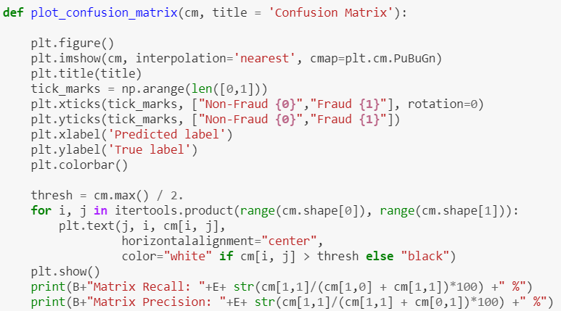
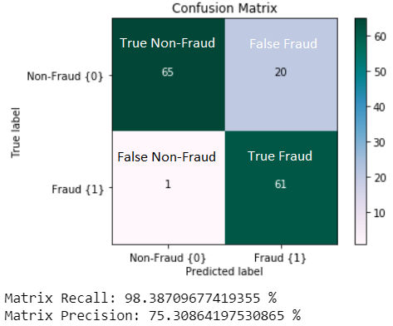
As shown, k-NN had a high recall rate but the precision wasn’t as high.
Recall and precision affect each other inversely. Higher recall would lead to lower precision and vice versa.
Maximizing both is ideal, but Recall should be prioritized as it maximizes the detection of frauds (both real and fake). Whereas precision affects the rate of false alarms, an innocent result compared to the prior.

Slide 30
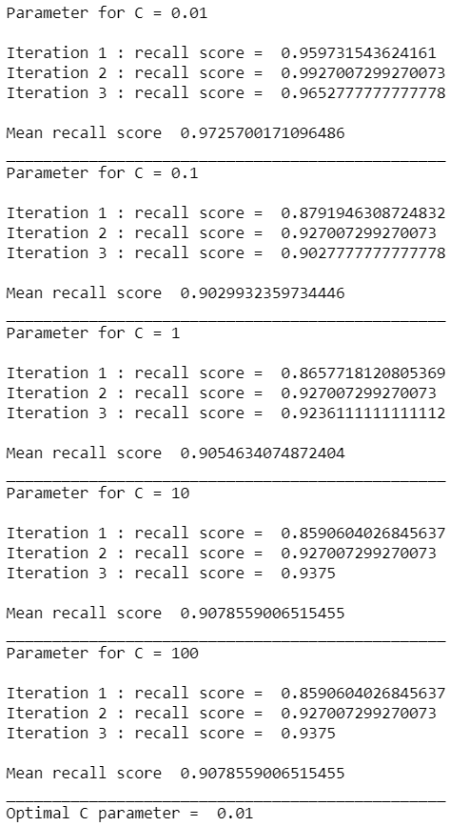
Logistic Regression
First, the optimal C parameter for LR was found through iterating 3 KFolds.
Run k-fold cross validation (3-folds) for every value of C and recall score was returned per fold. The recall scores per iteration were averaged out.
It was determined that C parameter of 0.01 was optimal for the best mean recall score.

Slide 31
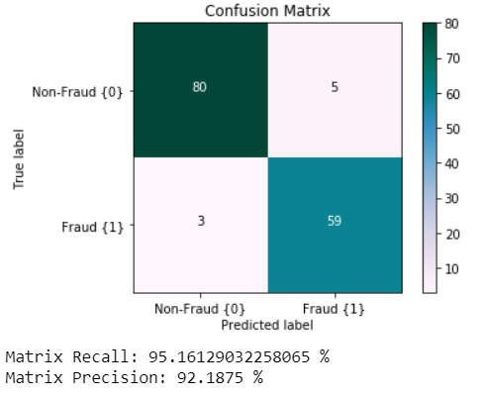
Confusion Matrix for Logistic Regression
With a high recall and precision score, it is safe to say that Logistic Regression was a good approach to classifying credit card fraud.

Slide 32
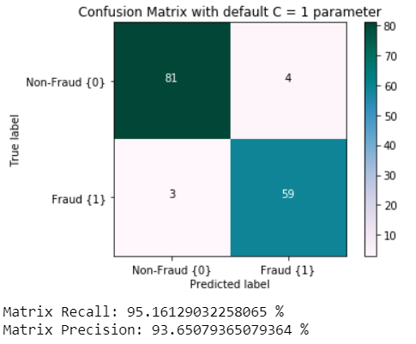
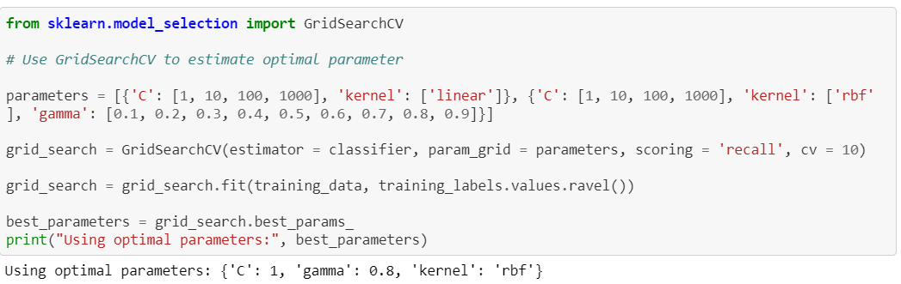
Support Vector Machine Classifier
The default C value of 1 was used originally. Then the optimal C value was found using GridSearchCV and inputting C params 1,10,100,1000, linear and rbf kernels, and gamma values. Solving the best recall score params.
It was discovered that C = 1 was indeed the optimal parameter with a non-linear Radial Basis Function kernel. Gamma is the free parameter for rbf. Smaller Gamma means less variance meaning support vectors have larger influence over the model.

Slide 33
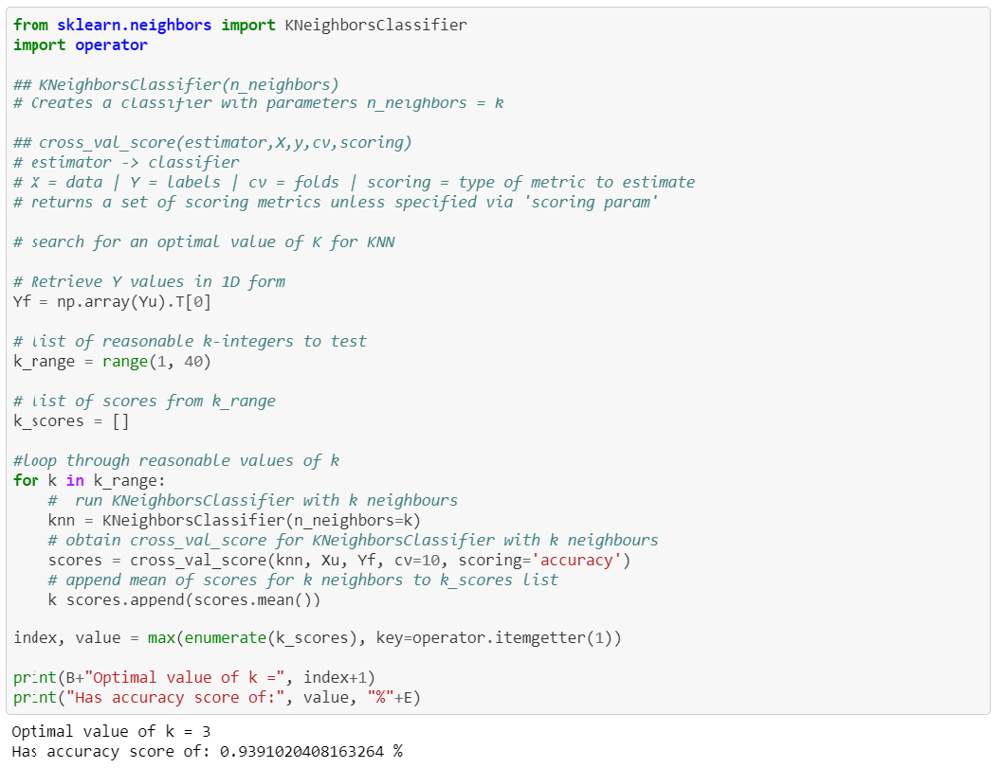
Finding optimal k on full dataset using accuracy score
Using cross validation on the full data, sklearn was used as the custom k-NN algorithm could not process the entire 285,000 samples.
The best accuracy of 93.9% was found with k = 3. Accuracy is a balance between maximizing Recall and Precision.

Slide 34
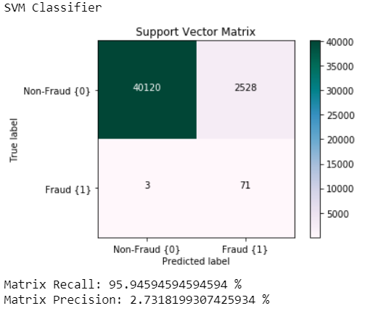
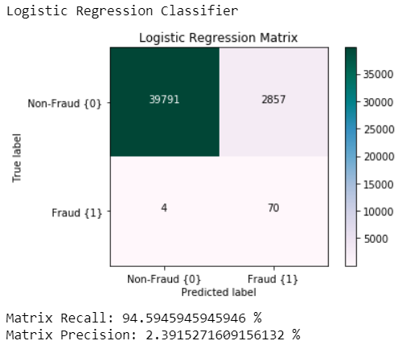
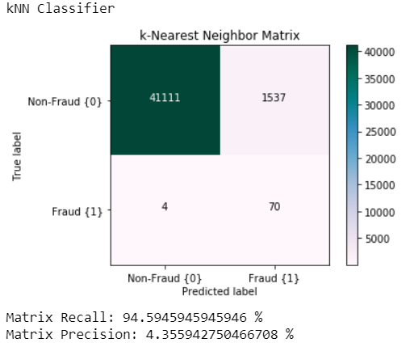
Comparing the Three Approaches with the entire dataset
In conclusion:
The models were all very high in recall
The recalls varied slightly and were different for each different scrambled sub-set.
It was noticeable that k-NN had consistently highest precision, meaning it was the best model for fraud detection along with least false alarms.
This was is due to the focus on the accuracy metric vs. recall metric when finding the optimal k value.
Accuracy is a balance between recall and precision.
Given already an almost capped recall, an increase of precision would drastically help reduce the number of false frauds detected.

